Slide 1


Slide 2
Welcome
Zoom rules
Meeting Guidelines
Approval of June Minutes

Slide 3


Slide 4
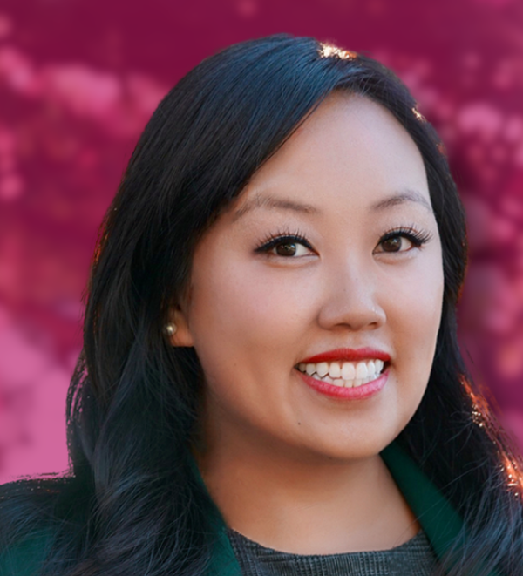
Sacramento City Councilmember
MAI VANG
District 8

Slide 6
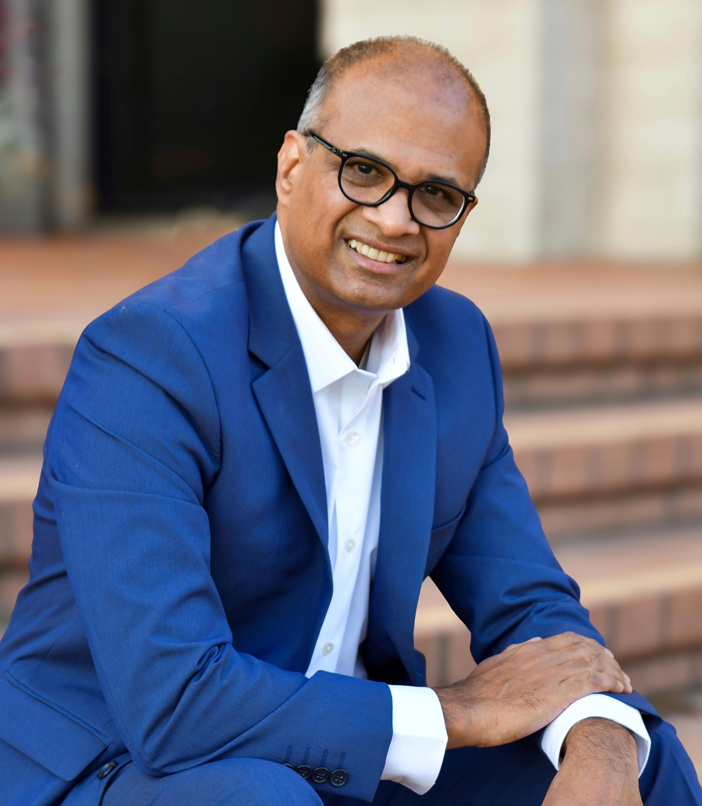
President’s Message

Slide 7
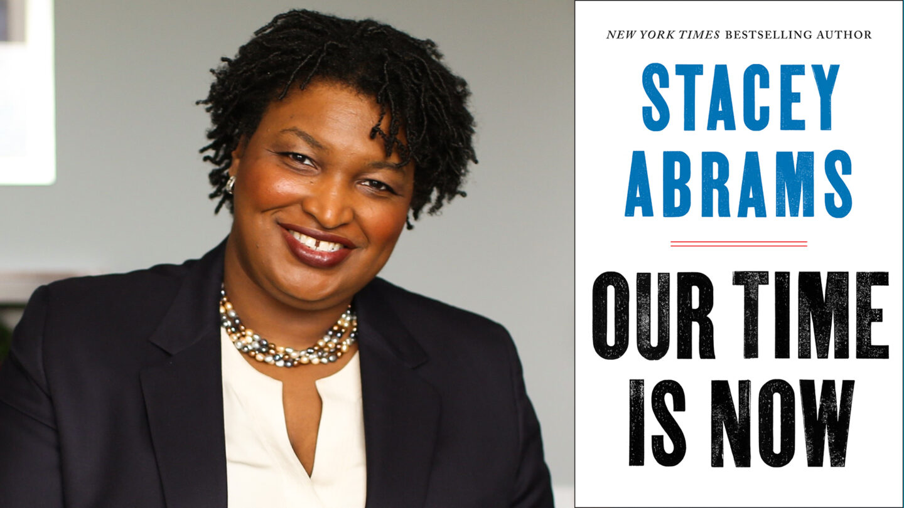
President’s Message
Power of
Grassroots
Organizing

Slide 8
FADC Board Election Timeline
Form Nomination Committee
Board Election – Members Vote
Board Term Begins.
Jul
Aug
Sep
Oct
Nov
Dec
Jan
Announcement
Nominated Candidates announced.
Transfer of power begins.

Slide 9
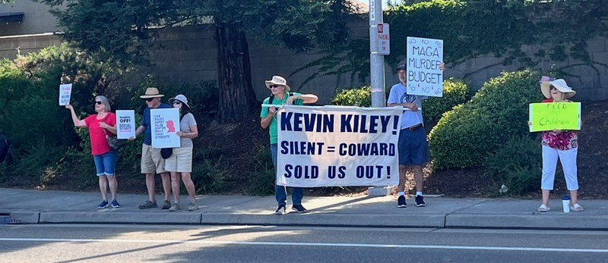
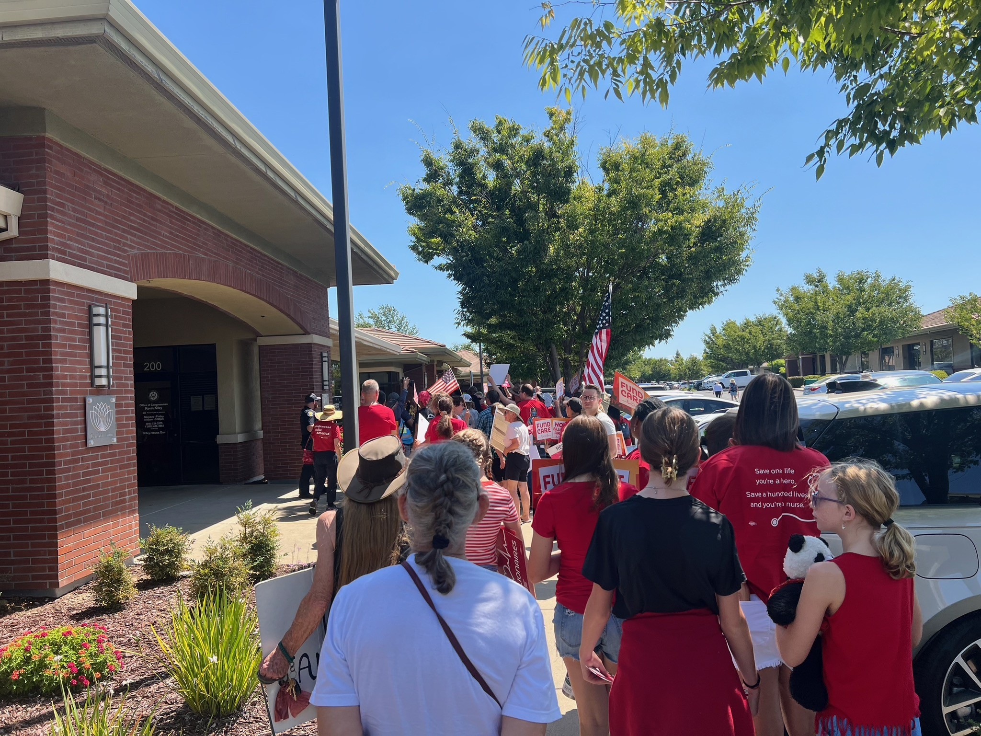

GOOD TROUBLE
Lead: Susan

Slide 10
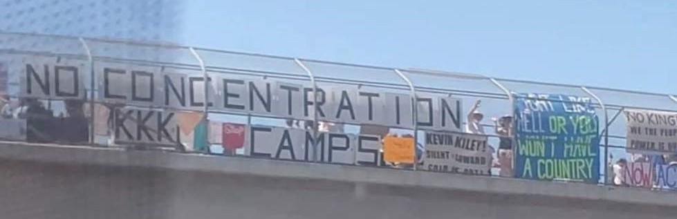
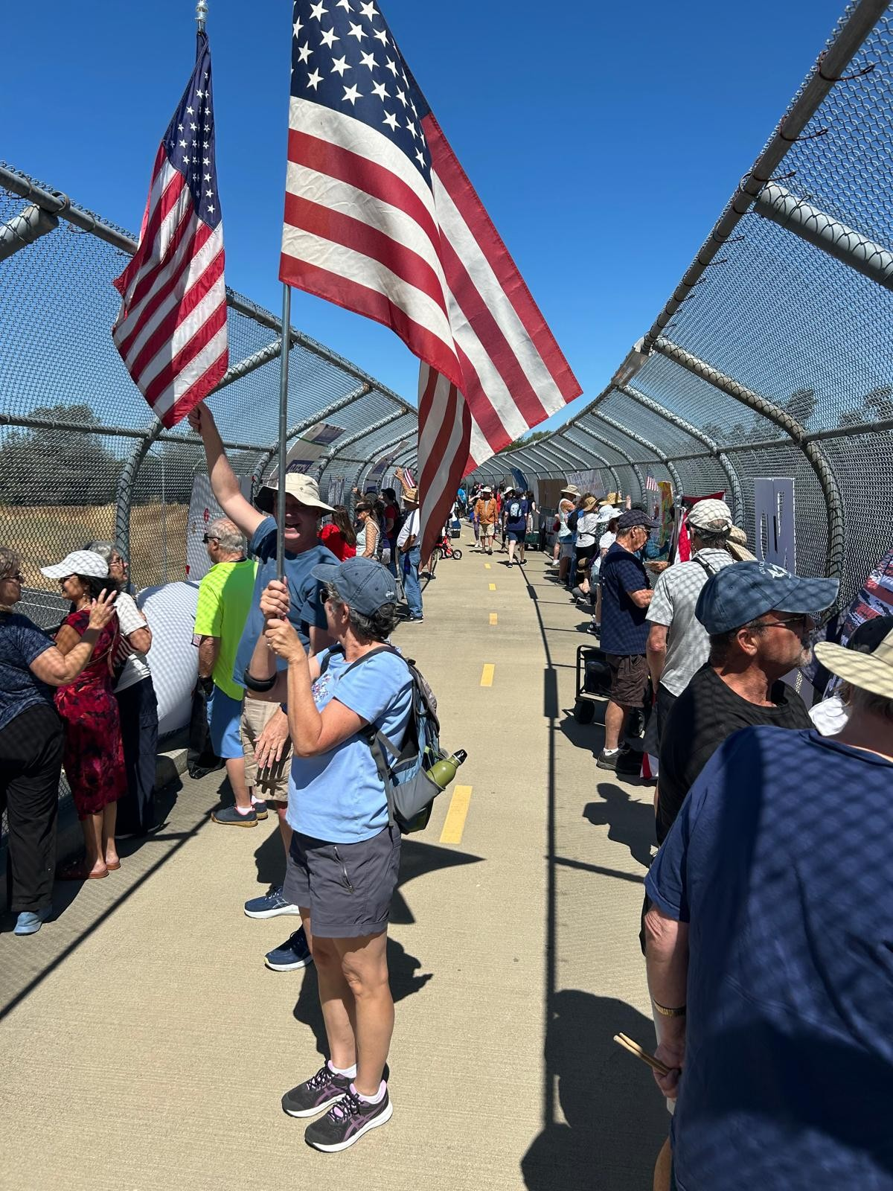
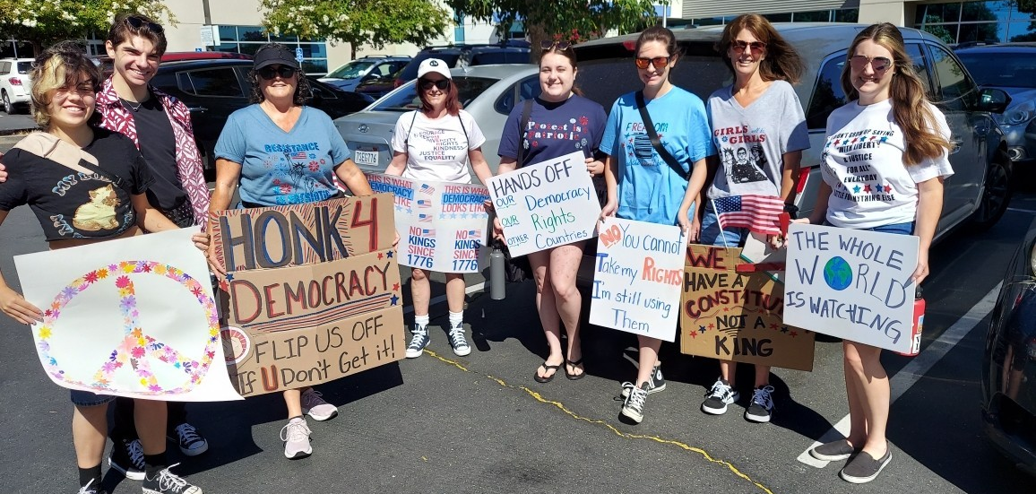
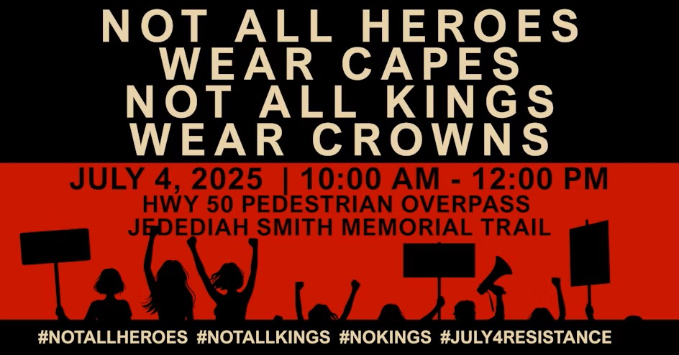
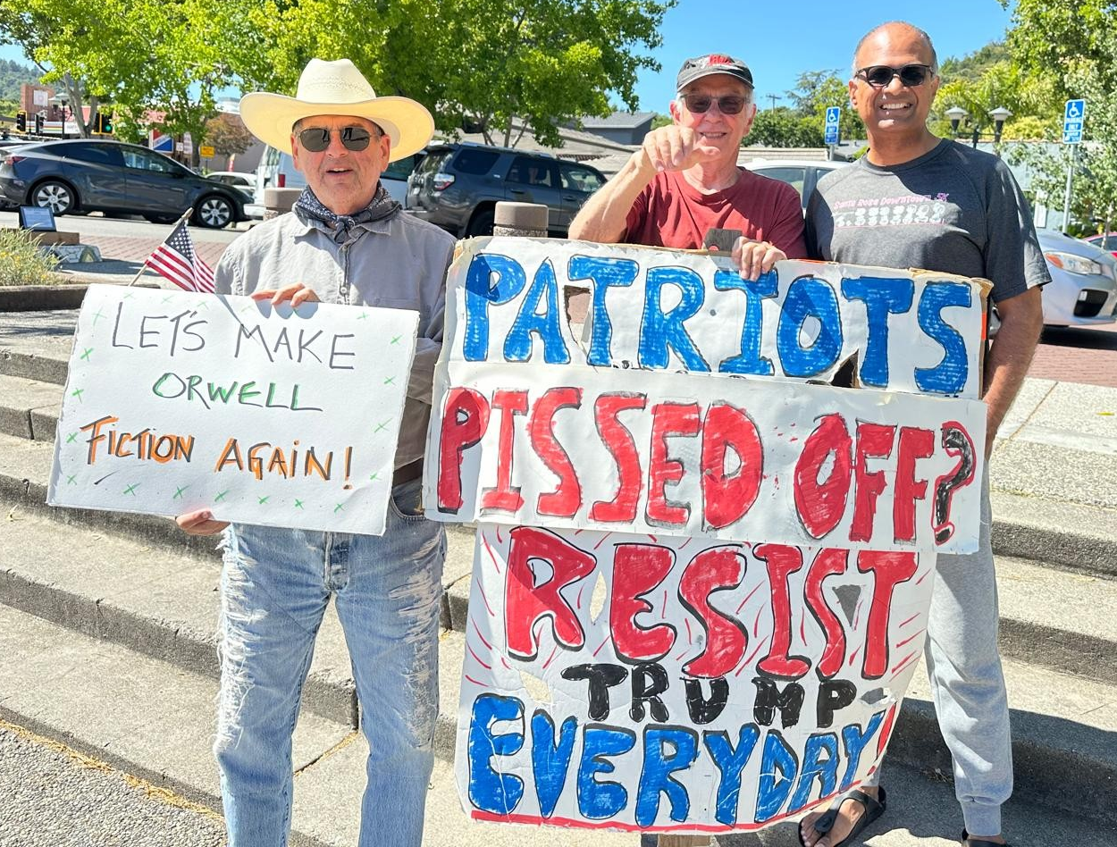
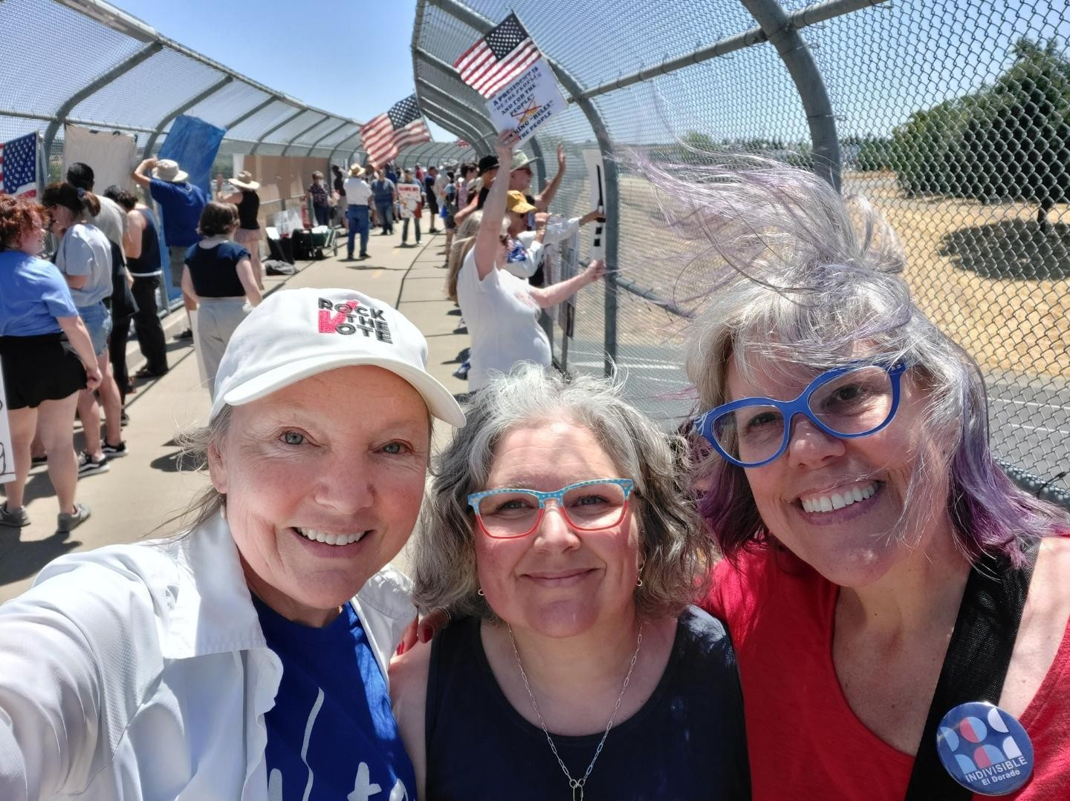
GOOD TROUBLE
Lead: Susan

Slide 11

GOOD TROUBLE
Lead: Susan
"GOOD TROUBLE" PICNIC & BANNED BOOK DRIVE
70 banned books collected
40 participants

Slide 12
FOLSOM CITY COUNCIL TEAM
Lead: Andy
To lease or not to lease…
Light my fire!

Slide 13
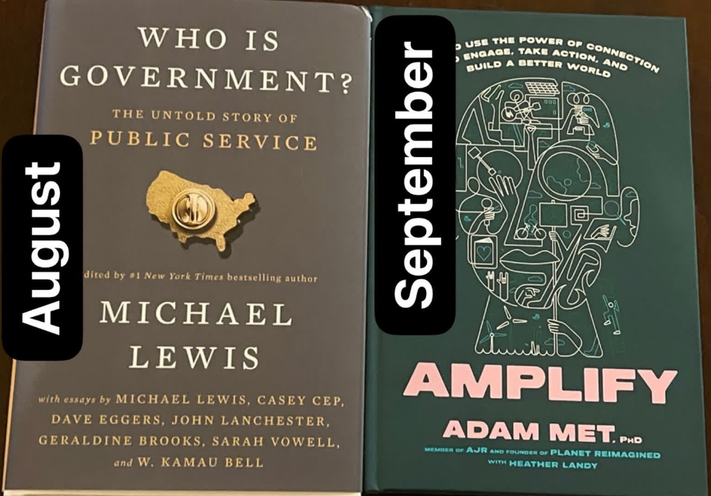
Bookish club in July read The Message by Ta-Nehisi Coates
"The beautiful thing about learning is that no one can take it away from you." Ta-Nehisi Coates
“My sense is that if I spend more time talking to you than I spend complaining about you, then something wonderful often happens and the enlightenment is mutual. So I don't really worry about the young, whose excesses are confined to lecture halls and quadrangles, so much as I fear the old, whose tyrannies are legislative.”
― Ta-Nehisi Coates, The Message
BOOKISH
CLUB
Lead: Jen

Slide 14

COMMUNITY SERVICE TEAM
Lead: Sarah P
MERCY HOUSING FOLSOM
Coming Up…
Back to School Lunch Party for kids at Mercy Village and Folsom Gardens I & II
  First week of August
Folsom Community Service Day
  September 20
  FADC Project: Mercy Housing Landscape Projects
Look out for the announcement to volunteer!

Slide 15
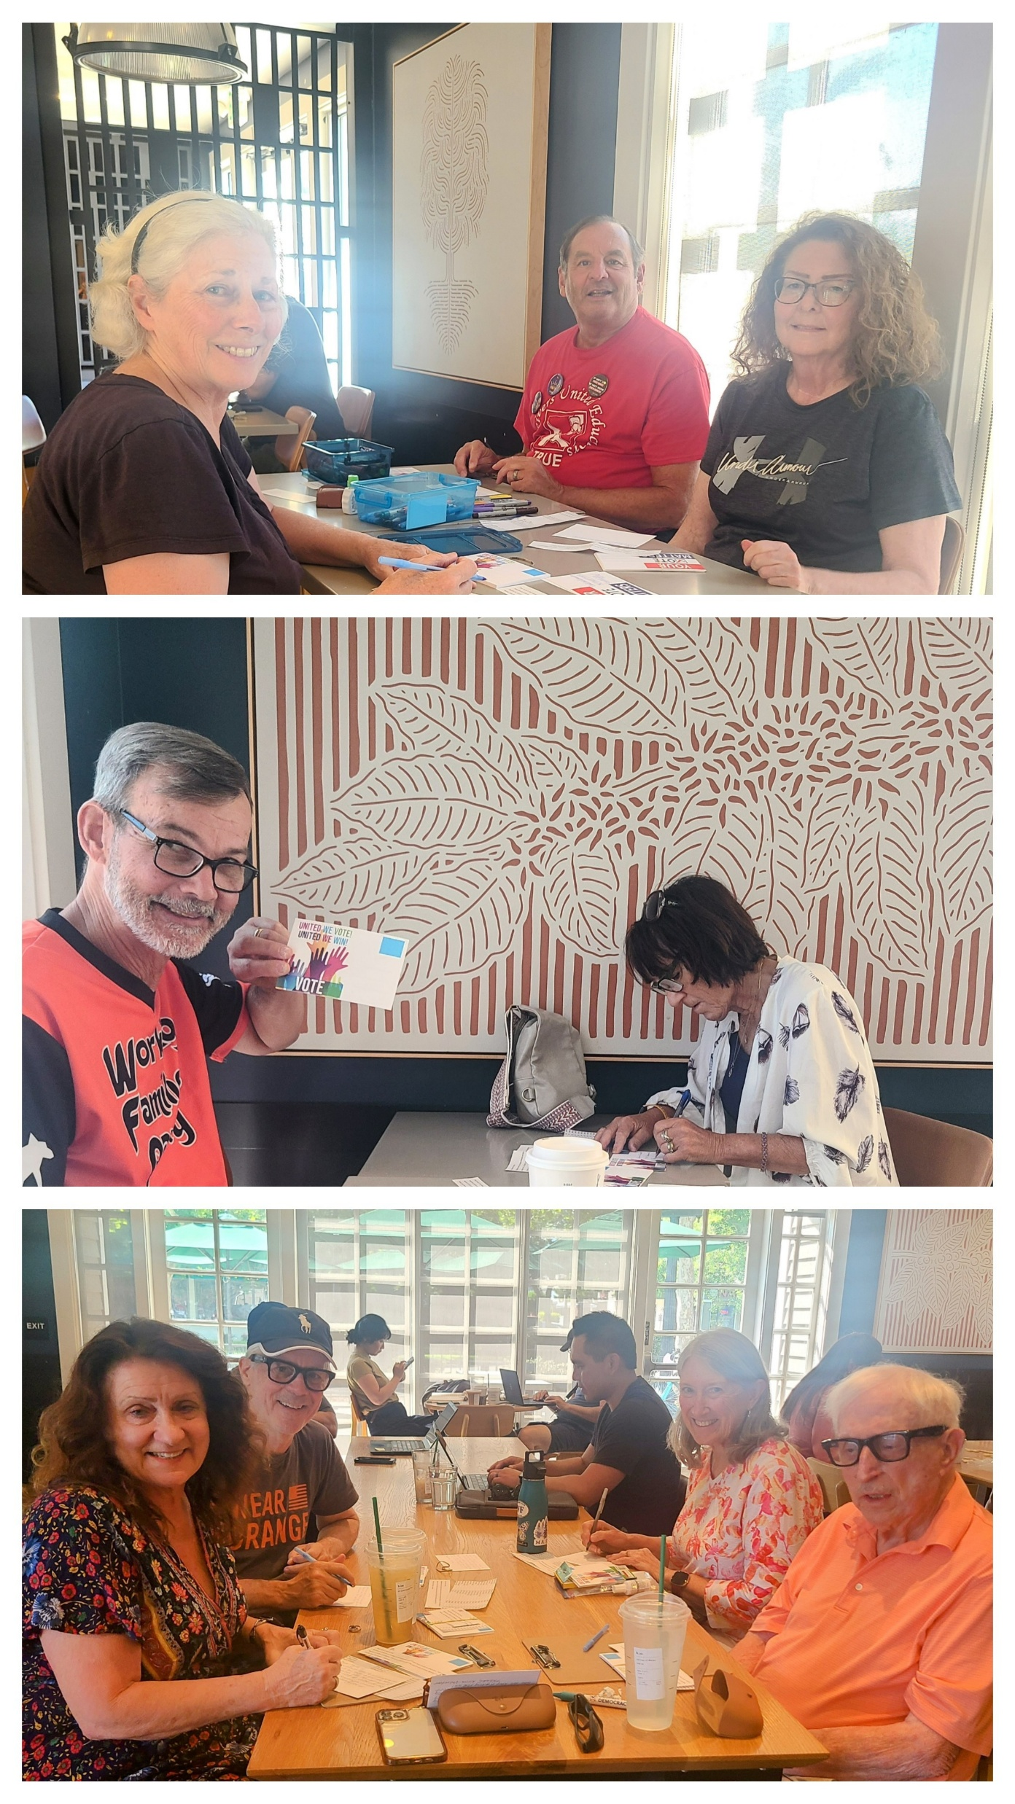
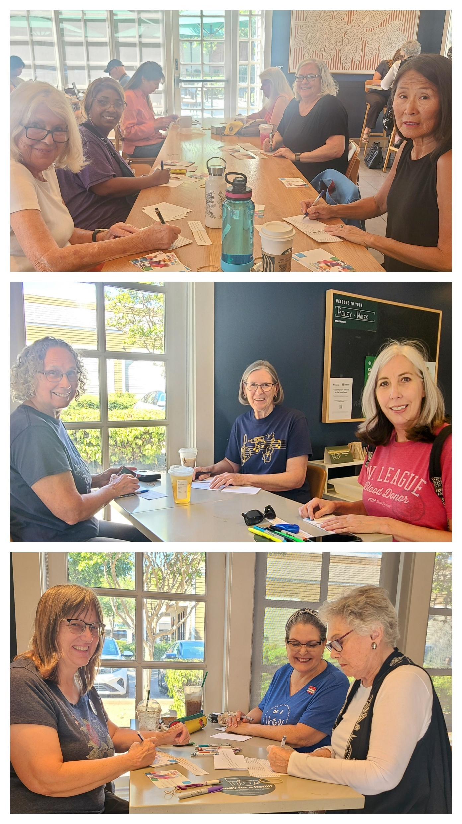

“THE WRITE STUFF”
Co-Leads: Tammy & Coral

Slide 16
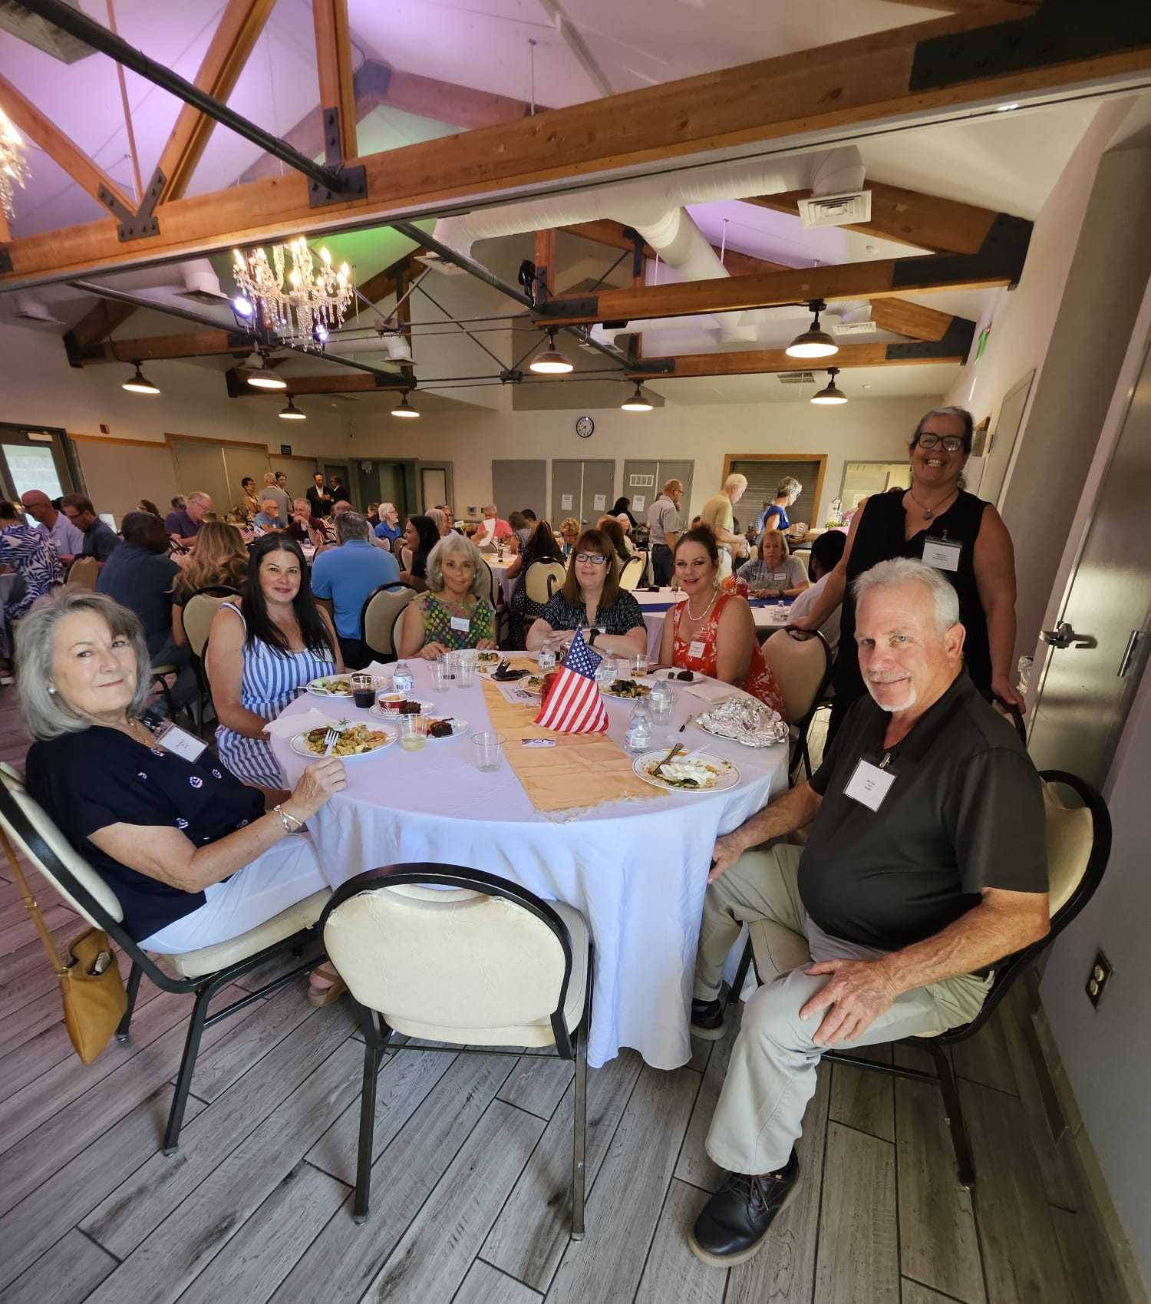
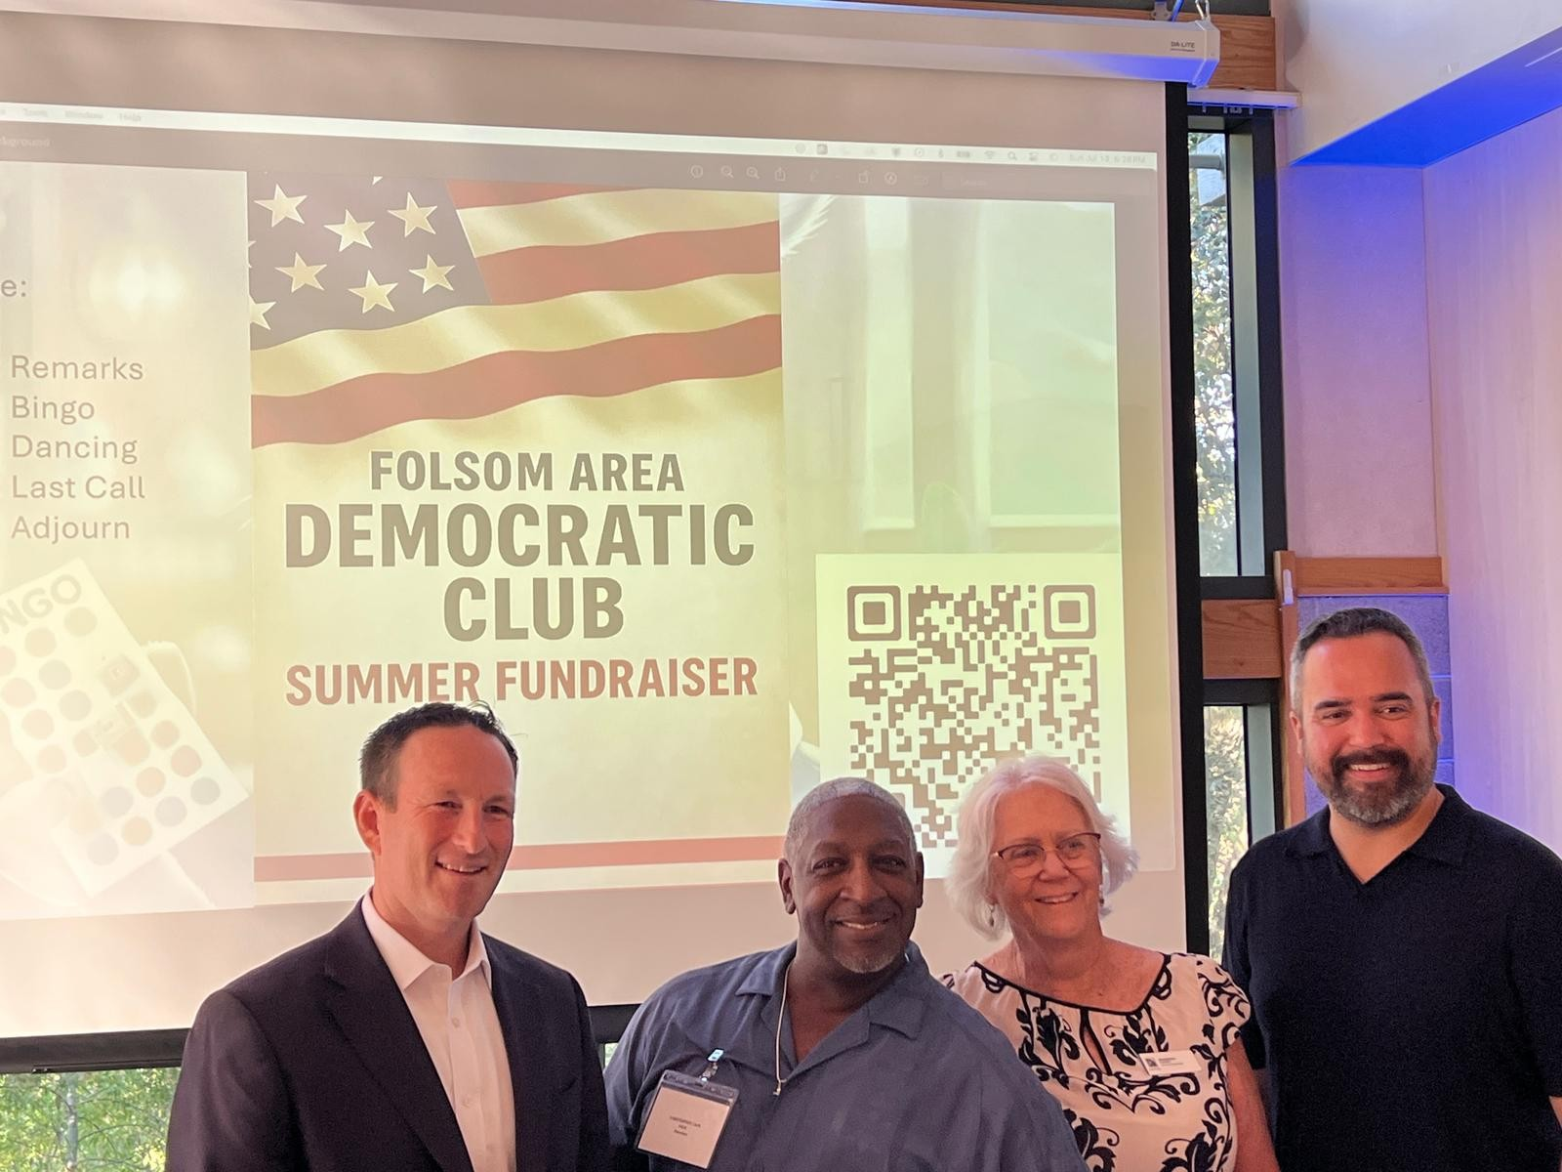
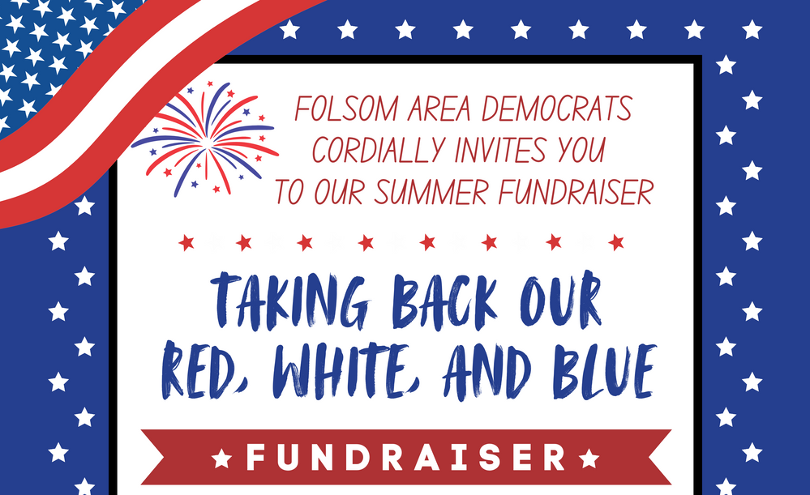
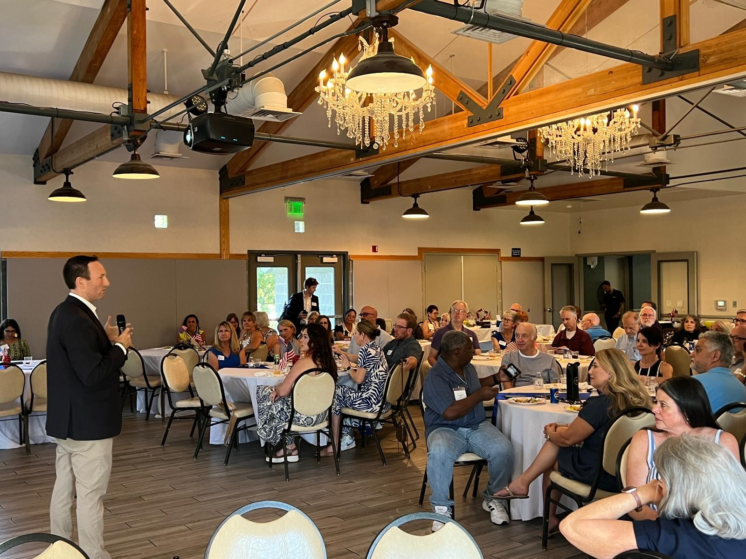
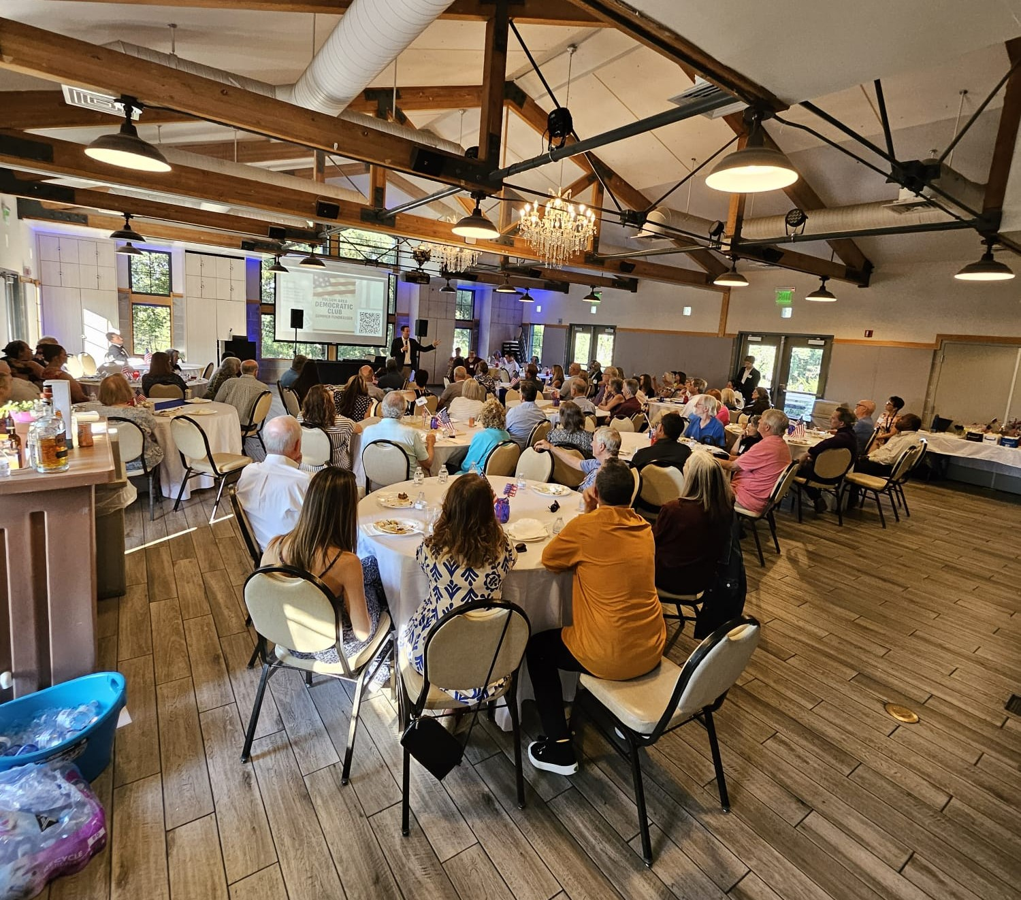
SUMMER FUNDRAISER
Chair: Dolly

Slide 17

CENTRAL
COMMITTEE
REPORT
Lead: Teresa

Slide 18


